Slide 1
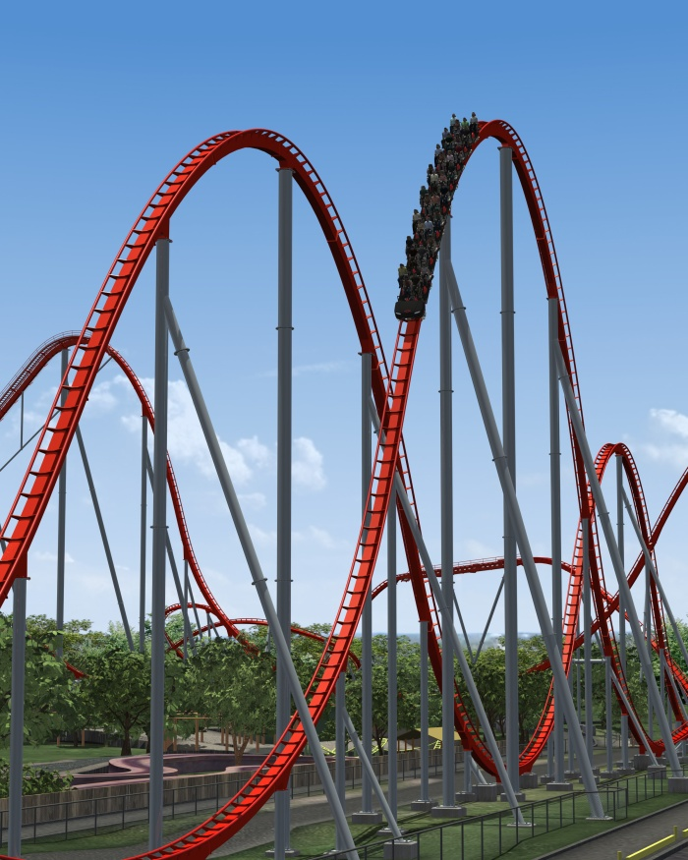
Government & the U. S. Economy
What does the government do to keep the U.S. economy from acting like a roller coaster:
RECESSION
less individual spending & higher unemployment
INFLATION rising prices and and a lot of individuals spending money

Slide 2
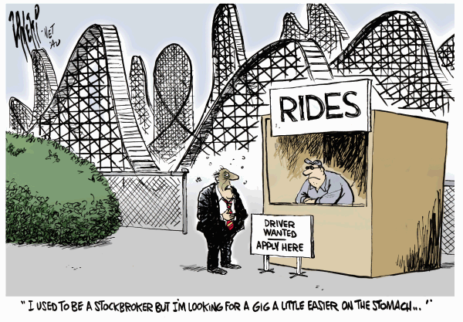

Slide 3
Imagine that the U.S. economy is like a campfire.

Slide 4
If the campfire gets too big, that’s bad!

Slide 5
If the economy grows too large, we have high prices and inflation.

Slide 6
If the economy grows too rapidly, the government would decrease the amount of money in circulation to slow economic growth.
If the fire became too big, you could remove some sticks and logs to make the fire slow down.

Slide 7
The government tries to slow down inflation in several ways:
Congress can raise taxes so that businesses and individuals have less money to spend.
The Treasury Department can borrow more money by selling bonds.
The government can decrease the amount of money it spends.
But don’t forget about the role of…

Slide 8
(The Federal Reserve System)
The “Fed”
One of the functions of the Federal Reserve is to help maintain a stable economy.
One way it does this is by raising or lowering the interest rate they charge to banks.

Slide 9
If there is inflation, the Fed can raise interest rates to make it harder for individuals and business to borrow money. This also encourages individuals to save more money in the bank, leaving less money in the economy.

Slide 10
Back to the campfire…
If the campfire gets too small, the fire goes out and that’s bad!

Slide 11
If the U.S. economy slows down and shrinks, we have a recession that could lead to an economic depression.

Slide 12
So what does the government do to try to keep the economy stable?

Slide 13
If the economy slows too much, the government would increase the amount of money in circulation to stimulate economic growth.
If the fire is low, you would add sticks and logs to make the fire grow larger.

Slide 14
It can do this in several ways:
Congress can lower taxes so that business and individuals have more money to spend.
The Treasury Dept. can buy back bonds to put more money into the economy.
The government can increase the amount of money it spends.
But don’t forget about the role of…

Slide 15
(The Federal Reserve System)
The “Fed”
If there is a recession, the Fed can lower interest rates to make it easier for individuals and business to borrow money.

Slide 16
Your Turn!!! If the country is in a recession, the government might _______ taxes so that there is ______ money available for businesses and individuals.
lower
more

Slide 17
Your Turn!!! If the country is experiencing high inflation, the Federal Reserve might _________________ causing banks to _________________ which leaves less money available for ______________________________.
raise interest rates
lend less money
businesses & individuals to borrow

Slide 18
Your Turn!!! The country is in a bad recession and many people are out of work. The government might _________ its spending so that there is ______ money in the economy.
increase
more
How would this help create new jobs?

Slide 19
Your Turn!!! The government recognizes a problem with the economy and decides to start selling more bonds to the public.
Will this action increase or decrease the amount of money in the economy? Why?
Does this show the country experiencing inflation or a recession?
How do you know?

